Slide 1
Hedera Dynamic Flow Scheduling for Data Center Networks
Authors: Mohammad Al-Fares, Sivasankar Radhakrishnan,
Barath Raghavan, Nelson Huang, Amin Vahdat [2010]
Presenter
Baran Kaya

Slide 2

OUTLINE
Introduction
Data Center Networking
Fat Tree network architecture
Static Load Balancers → ECMP and VLB
What is Hedera?
Hedera Algorithms
Simulation and Test
Results and Evaluation
SDN
Conclusion

Slide 3
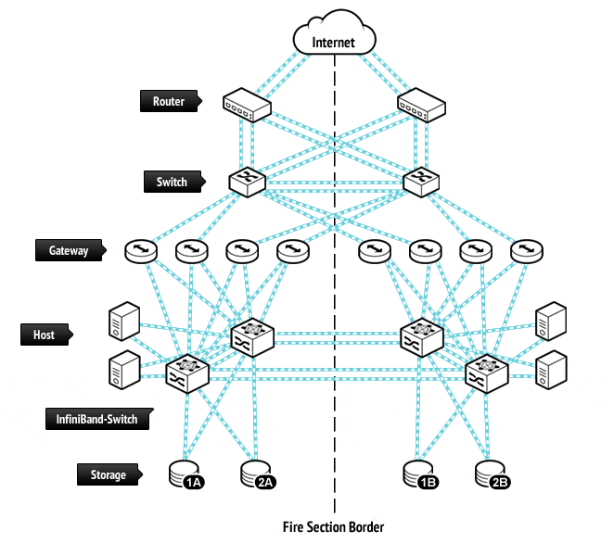
INTRODUCTION
Datacenters with thousands of machines
High bandwidth connections
Multi-rooted tree networks
Multi-pathing → Static hashing
Hedera → Dynamic flow scheduling
8192 hosts → 96% optimal and 113% better load balancing
Non-blocking switch for comparison (support all ports at full forwarding capacity)
Notes:
Non-blocking switch is a switch that can support all ports at full forwarding capacity concurrently

Slide 4
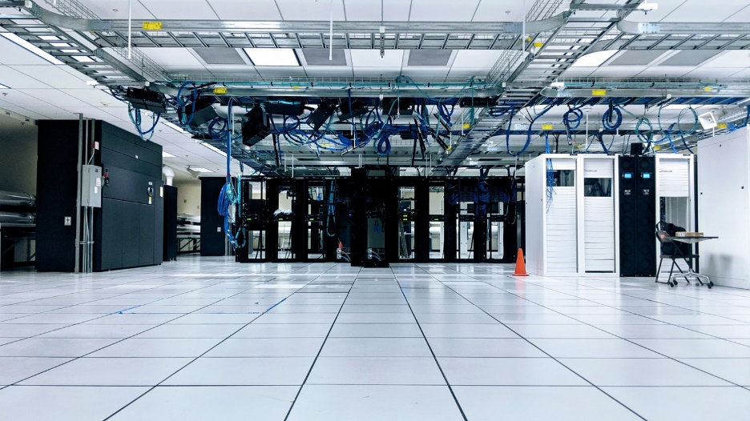
DATACENTER NETWORKING
Why DC network design is difficult?
Unknown workloads (time & space)
Customer applications run on commodity OS, requires high bandwidth
Virtualization: application may not run on the same rack
Multi-rooted tree network with higher-speed links
There are many paths between all hosts
Minimize flow collision → Higher aggregate bandwidth
Static forwarding → Single path for the whole flow

Slide 5
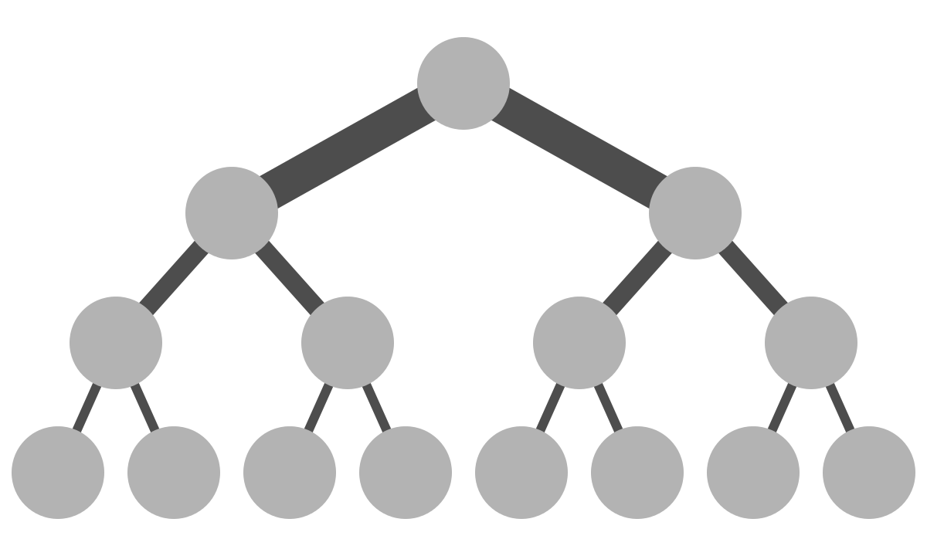
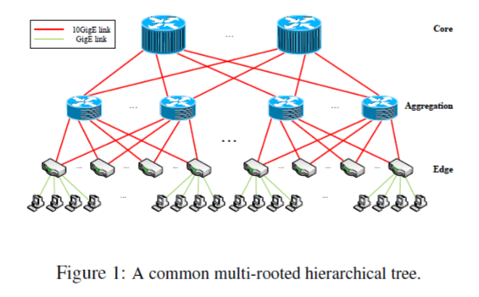
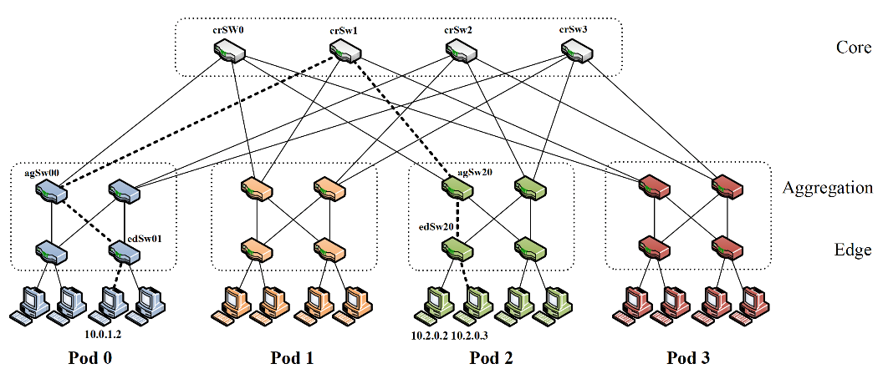
FAT-TREE NETWORKS
Tree data structure → Every branch has the same thickness
Fat tree → Top branches thicker

Slide 6
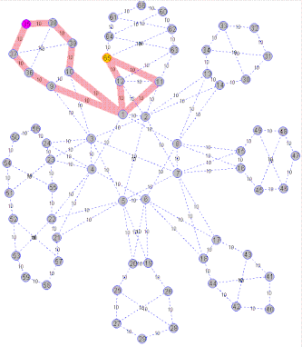
ECMP & VLB
Equal Cost Multipath (ECMP)
Hash based algorithm
Header data (source, destination)
Valiant Load Balancing (VLB)
Random “core” switch
Per-flow → Similar to ECMP
Per-packet → Requires packet ordering
Both are static load balancers
ECMP animation using 802.1aq protocol
Notes:
When a packet with multiple candidate paths arrives, it is forwarded on the one that corresponds to a hash of selected fields of that packet’s
headers modulo the number of paths , splitting load to each subnet across multiple paths. This way, a flow’s
packets all take the same path, and their arrival order is maintained
Bouncing individual packets from a source switch in the mesh off of randomly chosen intermediate “core” switches, which
finally forward those packets to their destination switch. Recent realizations of VLB perform randomized
forwarding on a per-flow rather than on a per-packet basis to preserve packet ordering. Note that per-flow VLB
becomes effectively equivalent to ECMP.

Slide 7
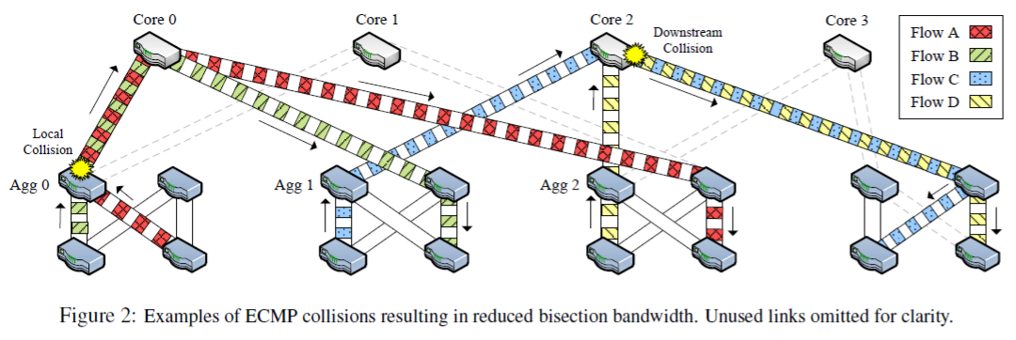
ECMP
1 2 3 4 5 6 7 8
2 or more large long-lived flows can collide → Bottleneck
A and B collision at Agg 0, C and D collision at Core 2
1 Gbps → 500 Mbps
A to Core 1, D to Core 3

Slide 8
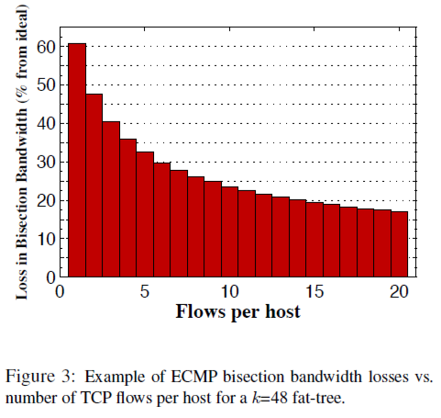
ECMP
3 stage fat-tree with ECMP (Flows hashed)
1GigE 48-port switches, 27k hosts
Each host transfers equal amount of data to all remote hosts one at a time
Hash collision → Reduce bisection bandwidth with → Average of 60.8%
Each host communicates with remote hosts in parallel across 1000 simultaneous flows
Hash collision bandwidth → 2.5%
Notes:
The intuition here is that if there are many simultaneous flows from each host, their
individual rates will be small and collisions will not be significantly costly: each link has 1,000 slots to fill and
performance will only degrade if substantially more than 1,000 flows hash to the same link

Slide 9
HEDERA
With efficient forwarding protocol, multi-rooted tree topology can deliver high bisection bandwidth.
Move flows from highly utilized links to less utilized links
Which flow?
Measure flows’ bandwidth and transfer the flow that the alternate can carry.
Flow’s bandwidth may not reflect the natural demand.
1. Detect large flows at the edge switches
2. Estimate natural demand and compute better path
3. Install new paths to edge switches
Notes:
Measure:
Which fit near perfectly
Demand:
1Gig link → flow need 500Mbps
Hedera supports any general multi-rooted tree topology.

Slide 10
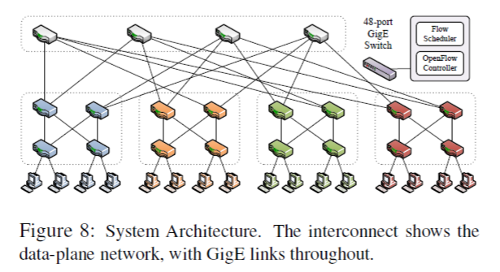
HEDERA
Goal: Spreading the traffic as evenly as possible among all core switches.
In Hedera packet path is non-deterministic
Chosen on its way up to the core
But deterministic → Going down
There is exactly one path from any
core switch to any destination host
There are fixed IP address in core
switches to any destination pods

Slide 11
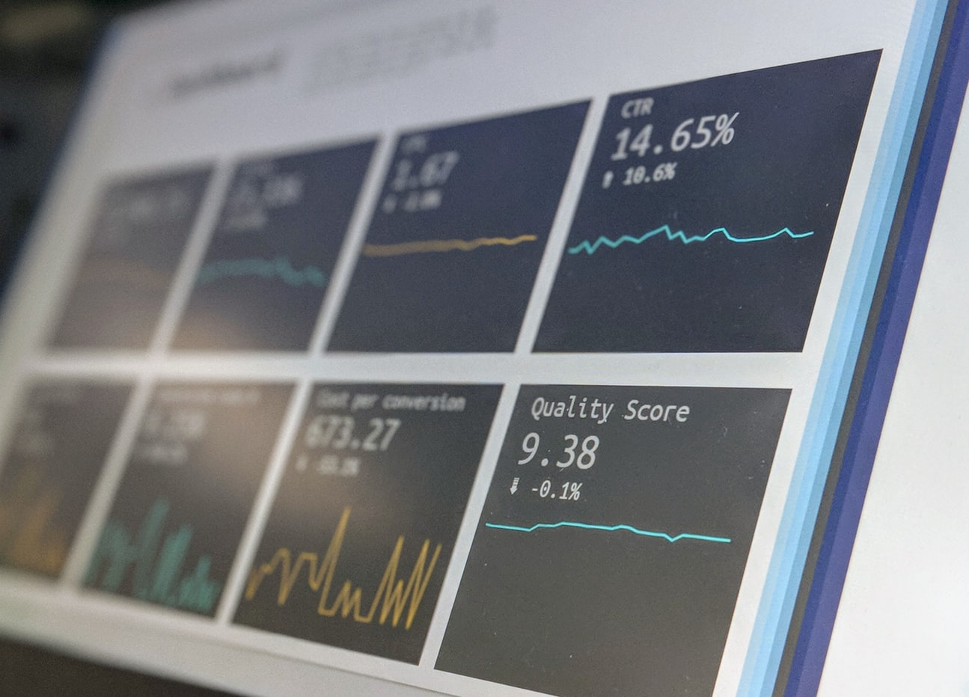
HEDERA
New flow → Use hash based forwarding (similar to ECMP)
Use this path until flow grows past a threshold rate
After threshold → Hedera dynamically calculates alternative path (placement)
Threshold for test & simulation → 100Mbps (10% of 1GigE link)

Slide 12
HEDERA
Hedera has a central scheduler for fail-overs and scalability
Dynamically changes the edge and aggregation switch forwarding tables
Uses current network-wide communication demand data
Uses one of the scheduling algorithms:
Global First Fit
Simulated Annealing
Both algorithms search new paths to increase bisection bandwidth
Paper compares these 2 algorithms

Slide 13
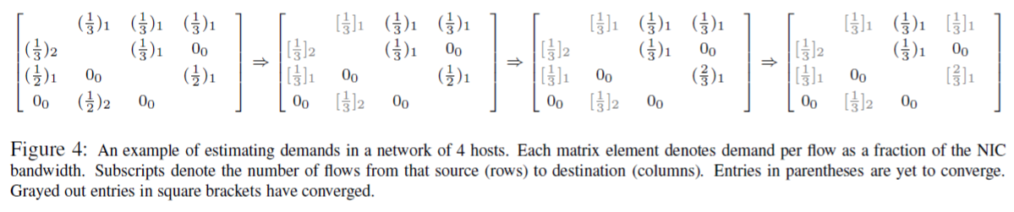
HEDERA ALGORITHMS
Flows: network-limited (bandwidth) or host-limited (RAM/disk)
Demand estimation algorithm → O(|F|)
H0 → H1, H0 → H2, H0 → H3, H1 2 flow→ H0, …

Slide 14
HEDERA ALGORITHMS
Global First Fit
Searches all possible paths to find a path whose link can carry that flow
Higher network load → Hard to find a suitable path
Does not guarantee that all flows will be accommodated
Simulated Annealing
Efficient probabilistic search, requires large search space, uses iterations
They assign a single core switch for each destination rather than for each flow
Searches through a solution space to find a near-optimal solution

Slide 15
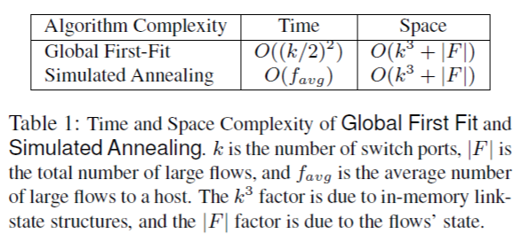
HEDERA ALGORITHMS
Global First Fit
Re-routes immediately upon detection
Simulated Annealing
Waits until next tick and uses previously computed flow to optimize
Both are simple algorithms.
More complex → More time to calculate → Performance decrease
Simulated Annealing is close to optimal and better than Global First Fit.
It is more complex but better calculation results tolerate that.

Slide 16
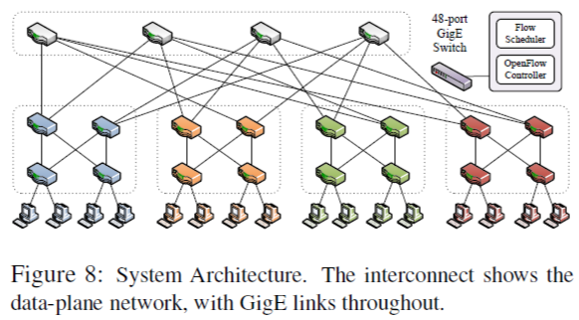
SIMULATION & IMPLEMENTATION TEST
Due to privacy and security concerns, DC traffic rates are not available
Synthetic communication pattern
k=4 pods
Pod lower layer → Edge switches
Pod upper layer → Aggregation switch
Edges have (k/2) hosts → 2
Pods are interconnected by (k/2)² core switches → 4

Slide 17
SIMULATION & TEST
Test scheduler updates every 5 seconds
Simulator with 8,192 hosts
Each simulation takes 60 seconds
Each host sending 1Gbps → 2.5 x 10¹¹ packets for 60 seconds run
Existing per-packet simulator with 1M packet per sec → 71 hours to simulate
Network graph with directed edges and accepts communication patterns
Measured the average bisection bandwidth during middle 40 seconds

Slide 18
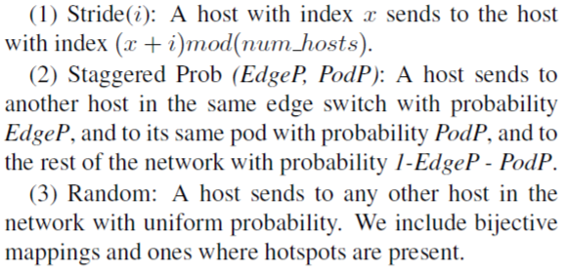
RESULTS & EVALUATION
# of hosts: 16, 1024 and 8192 with corresponding k: 4, 16, 32
Each test lasts 60 seconds and uses TCP flows

Slide 19
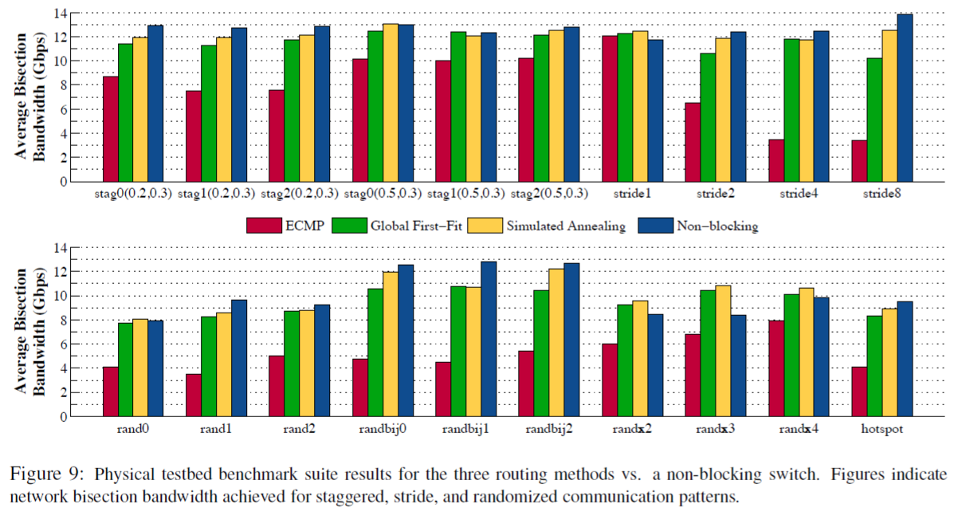
RESULTS & EVALUATION
Notes:
Algorithms against a hypothetical nonblocking switch
Naturally, the performance of these schemes improves as the level of communication locality
increases, as demonstrated by the staggered probability figures.

Slide 20
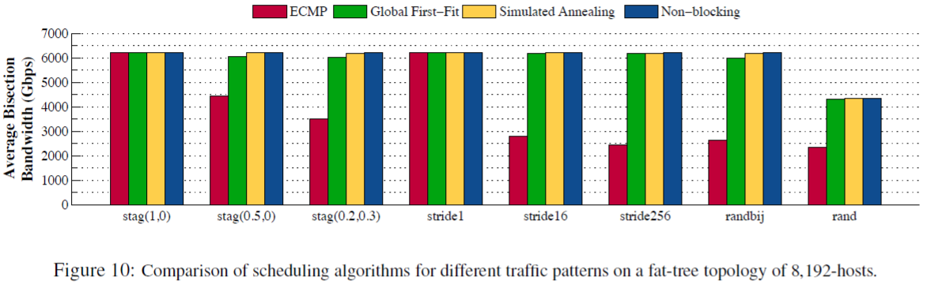
RESULTS & EVALUATION
Notes:
The performance of ECMP worsens as the probability of local communication decreases.
This is because even for a completely fair and perfectly uniform hash function, collisions in path assignments
do happen, either within the same switch or with flows at a downstream switch, wasting a portion of the available
Bandwidth.

Slide 21
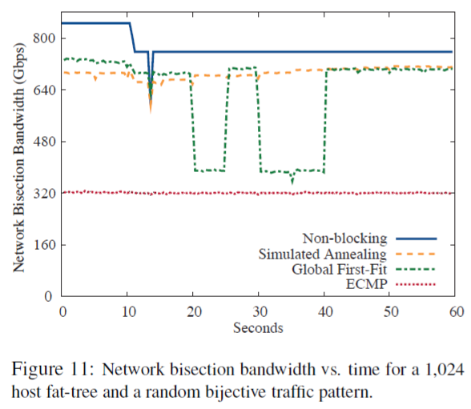
RESULTS & EVALUATION

Slide 22
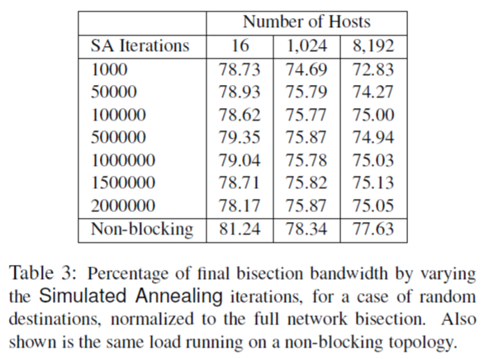
RESULTS & EVALUATION
Quality of Simulated Annealing
Few iterations for each decision is sufficient for performance
Even with less iterations outperforms static algorithms

Slide 23
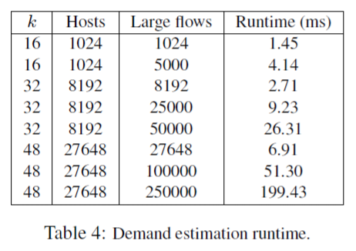
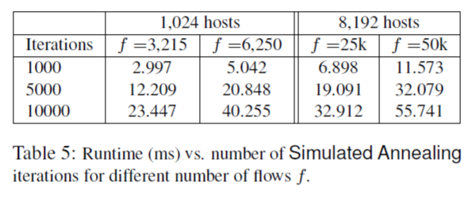
RESULTS & EVALUATION
4 parallel threads
Quad-cores, 2.13 GHz
250k flows (10 per host) → 200ms
Notes:
Common scenarios → 50-100 ms
250,000 machine → matrix memory 20MB → CPU L2 cache

Slide 24
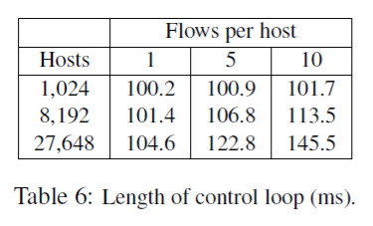
RESULTS & EVALUATION
Control loop:
1. Scheduler gets large flow information from all switches
2. Scheduler estimates flow demands and calculates their routes
3. Scheduler transmits the calculated data to all switches

Slide 25
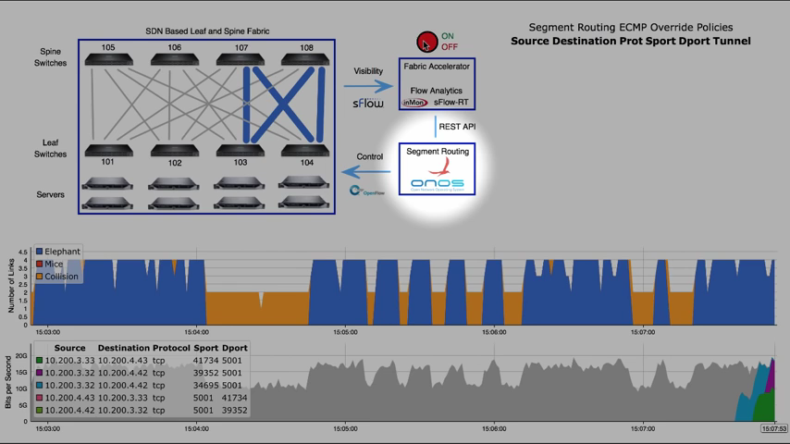
SDN
https://www.youtube.com/watch?v=QHWuHHmITiw

Slide 26
SDN
Software Defined Networks
Dynamic network management
Control plane and data plane
Control plane → Routing process/calculations
Data plane → Forwards packages
Programmable control plane → design, build and manage networks
2011 → Decouple control and forwarding planes
2012 → First interface for control and data planes

Slide 27
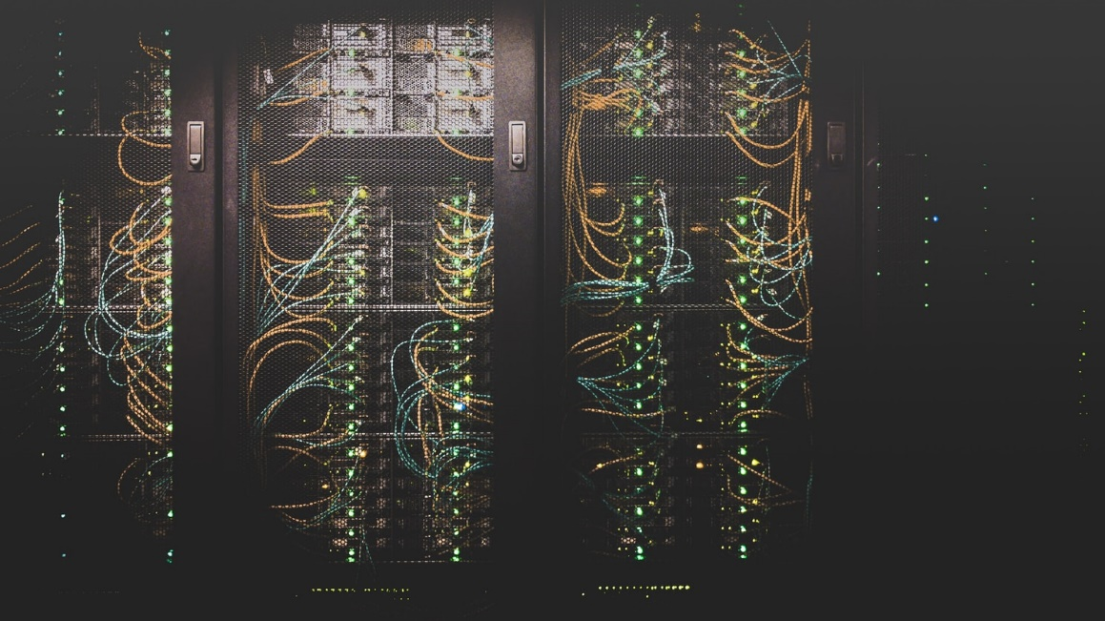
CONCLUSION
Static load-balancers can cause bisection collisions.
Central scheduler with global knowledge of active flows can outperform static hash-based ECMP load-balancing.
In almost every case Simulated Annealing is better than Global First Fit

Slide 28
Thank you
Al-Fares, Mohammad, et al. "Hedera: dynamic flow scheduling for data center networks." Nsdi. Vol. 10. No. 2010. 2010.
Images References
Outline, Hedera: Photo by Nika Akin on Unsplash
Data Center Networking: Photo by Taylor Vick on Unsplash
Hedera, Data Center: Photo by Stephen Dawson on Unsplash
Conclusion, Server: Photo by Taylor Vick on Unsplash

